Slide 1
ATLIQ MART SUPPLY CHAIN ANALYSIS
SHAIMA AFREEN

Slide 2
Outline
Executive Summary
Introduction
Methodology
Visualization
Insights
Conclusions

Slide 3
EXECUTIVE SUMMARY
Collected the dataset from Kaggle.com
https://www.kaggle.com/datasets/ashishyadav1993/atliq-marts-challenge
Imported the dataset in power BI.
Performed some transformations on the data.
Added some new measures as per the client’s requirement.
Analyzed the data by using various visualization charts on power BI.

Slide 4
INTRODUCTION
PROJECT BACKGROUND AND CONTEXT:
AtliQ Mart is a growing FMCG(fast moving consumer Good) manufacturer headquartered in Gujarat, India. It is currently operational in three cities Vadodra ,Surat and Ahmedabad. They want to expand to other metro/tier1 cities in the next 2 years.
AtliQ Mart is currently facing a problem where a few key customers did not extend the annual contract due to service issues.
It is speculated that some of the essential products were either not delivered on time or not delivered in full over a continued period, which could have resulted in bad customer service.
Management wants to fix this issue before expanding to other cities and requested their supply chain analytics team to track the ’On time’ and ‘In Full’ delivery service level for all the customers on a daily basis so that they can respond swiftly to these issues.
Problems you want to find answers:
Create the metrics according to the metrics list.
Create a dashboard according to the requirements provided by stakeholders.
Create relevant insights

Slide 5
Methodology
Datasets: There are six datasets.
dim_customers: This table contains all information about customers.
dim_products: This table contains all information about products.
dim_date: This table contains the dates at daily, monthly level, week numbers of the year.
dim_targets_orders: This table contains all target data at customer level.
fact_order_lines: This table contains all information about orders and each items inside the orders.
fact_orders_aggregate: This table contains information about InFull,OnTime,OnTimeInFull information aggregated at the order level per customer.

Slide 6
General terms in supply chain management:
Orders: An order contains information about the order. Who placed the order, what time they placed it, the shipping address associated, the billing address, payment method, when it was fulfilled, etc. It often does not contain any information about what was ordered.
Lines: The order line generally contains information about what was ordered, this is done because a single order can have multiple items in it. So the order line would specify the item ordered, the quantity ordered and the price charged, and there would be one line for each different item ordered.
Line Fill Rate(LIFR): It is an important metric for supply planning team to understand how many lines they shipped out of the total lines they ordered.
LIFR = (Lines fulfilled/Lines ordered)

Slide 7
Volume Fill Rate(VOFR): It is a similar metric for supply planning team to understand the total quantity they are able to ship for a customer per order or for a given period of time.
VOFR = (Total quantity shipped/Total quantity ordered)
ONTime% (OT%): It is a calculation of the amount of shipments delivered on time to the customer in relation to the total number of orders shipped.
InFull% (IF%): This measure is measured at order level. It determines if an order is delivered in full as per the requested quantity by the customer.
OnTimeInFull% (OTIF%): It is a KPI used for measuring how many orders were delivered on time and in full.It helps to assess whether the business was able to deliver every item in the order on or before the expected delivery date. This metric is mainly used as a delivery KPI.

Slide 8
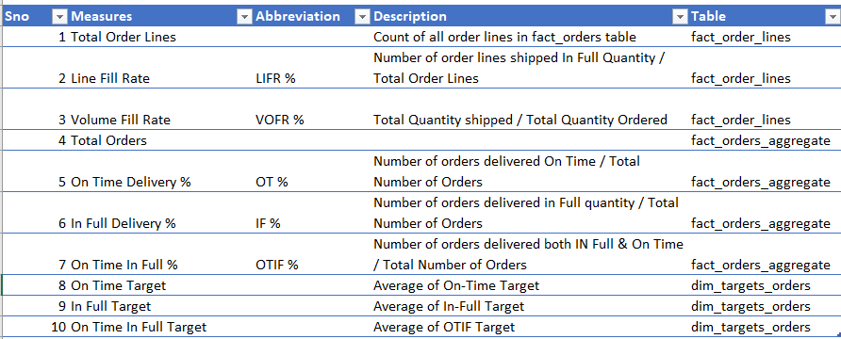
The new measures added were:

Slide 9
VISUALIZATION
Analyzed data by using different visualizations present in the Power BI desktop application.
For example, used cards to display IF%, OT%, OTIF%.
Used different charts like bar graph, pie chart to visualize the data.
The link to report is :
https://app.powerbi.com/links/pTlGSHxyQZ?ctid=2335c322-430f-4695-8746-529dd25ed072&pbi_source=linkShare&bookmarkGuid=b628cd32-7a3b-42d2-8637-c81d3191a0e6

Slide 10
INSIGHTS
At 59.03%, overall OT% is below target. Notably, customer named ‘Lotus Mart’ (28.11%) and ‘Acclaimed Stores’ (26.89%)are significantly below their individual targets.
Overall LIFR% is currently at 65.96%.1 segment have significantly lower LIFR% than others.
The quantity ordered was 13.42 Million but the delivered quantity was only 12.96 Million.

Slide 11
CONCLUSIONS
After analyzing the data, we need to pay more attention to the customers with less OTIF%.
Another thing to notice is total quantity ordered was 13.427 million but total quantity delivered was 12.969 million.
VOFR% is good but need to work on LIFR%.

Slide 12
THANK YOU

